Slide 1
Group 4 Final Project
Group Members:
Kennan Foust
John Harris
Marcia Joseph

Slide 2
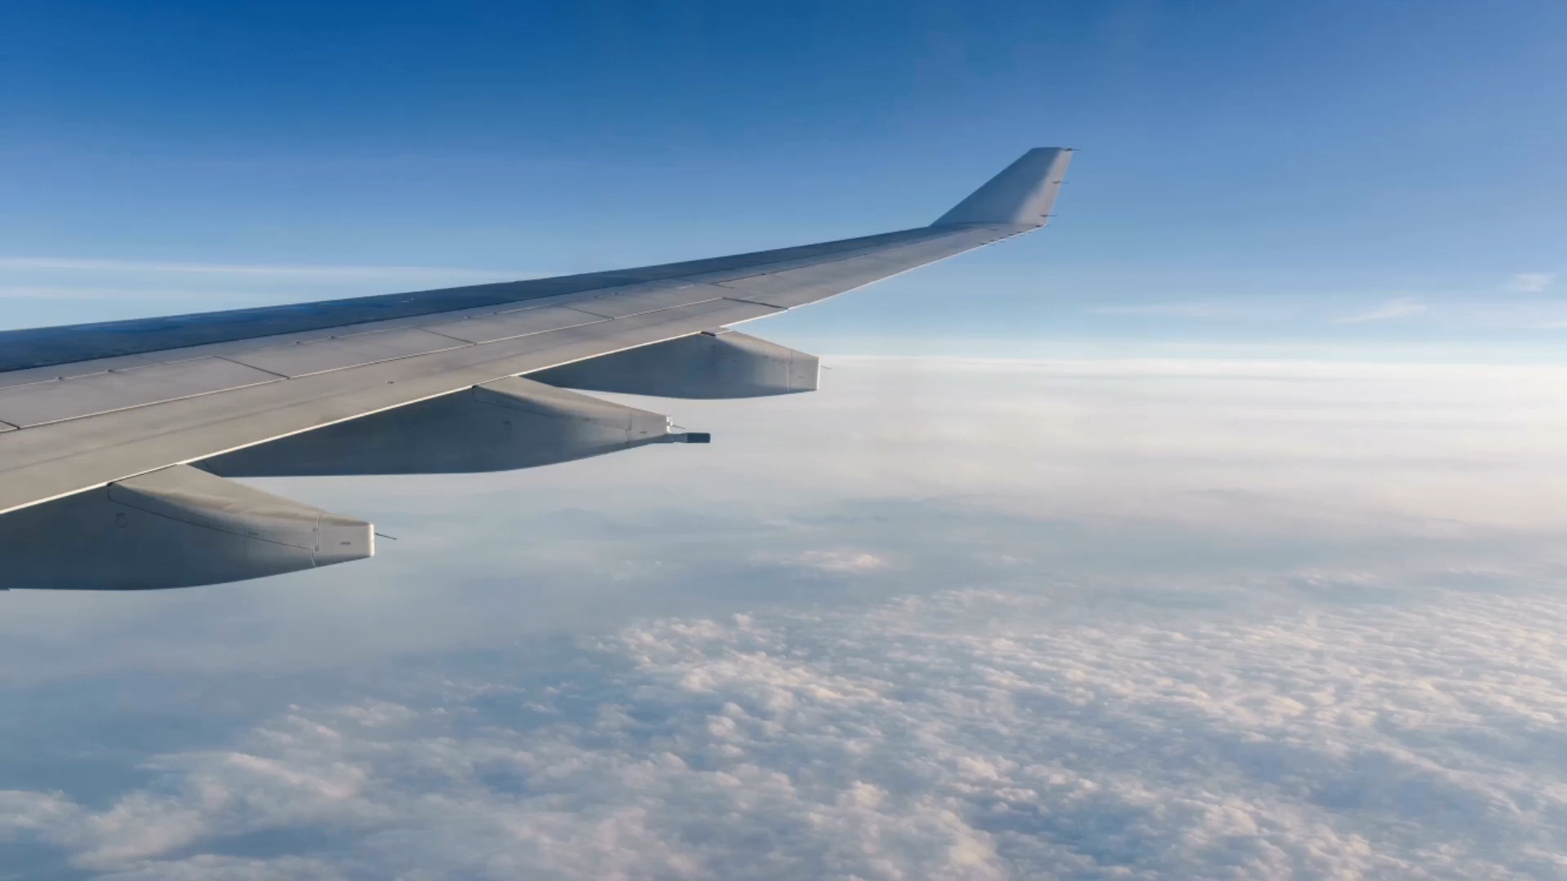
Flight Delays
Group 4
Final Project

Slide 3
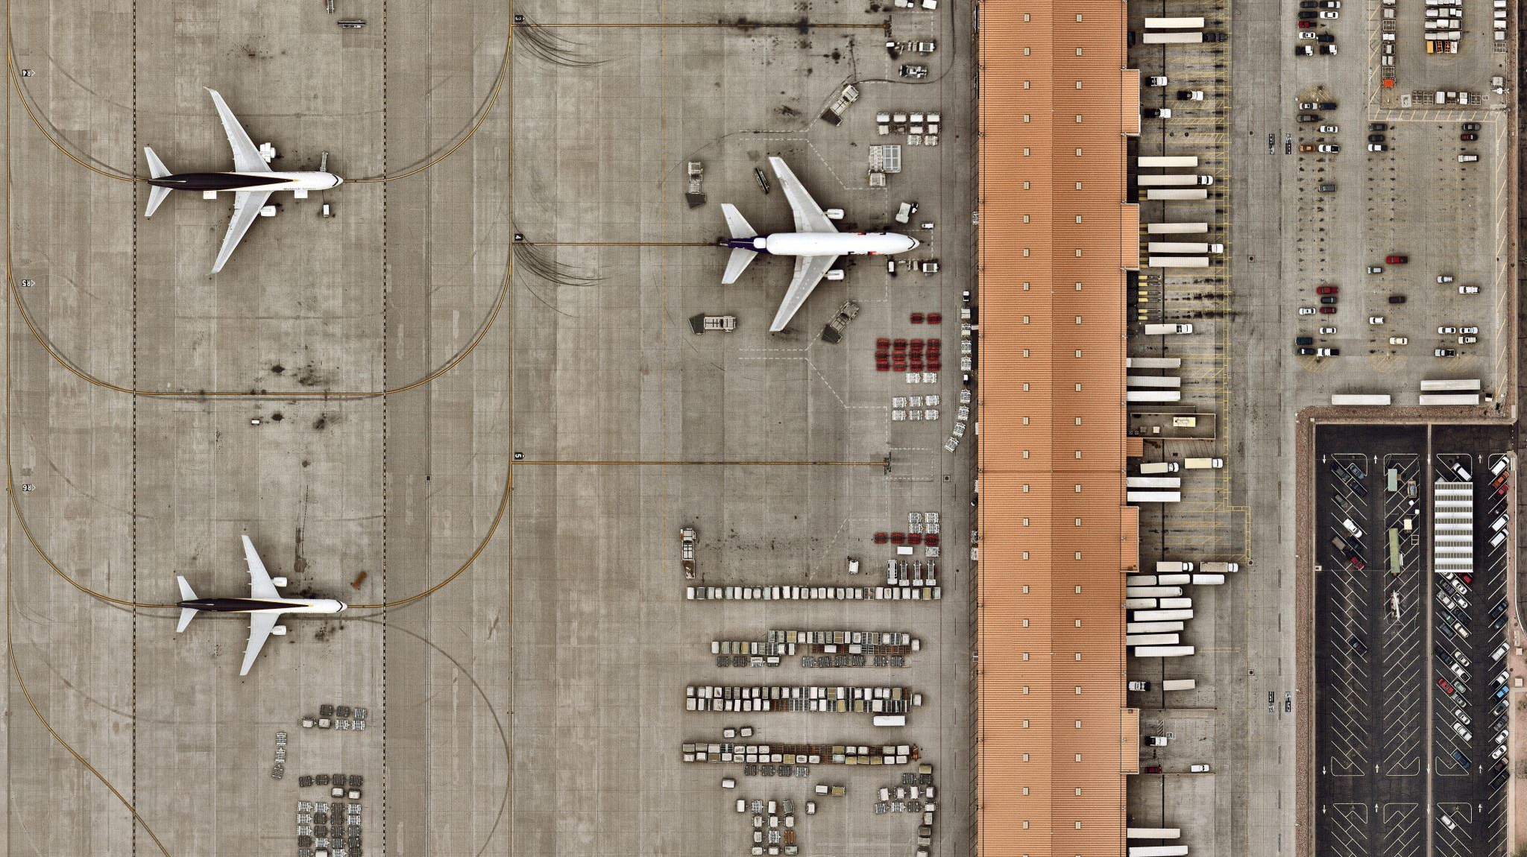
Flight Delays
Flight Delays, Best and Worst Airlines and Airports

Slide 4
Project Overview
January 2020 Flight Predictions
Predictive Problem: Flight Delays for the total flights in January 2020
Determine the Best and Worst Airlines for flight delays
Determine the Best and Worst Airports for flight delays
Data set came from Kaggle.com
https://www.kaggle.com/datasets/divyansh22/flight-delay-prediction

Slide 5
Introduction
Story line

Slide 6
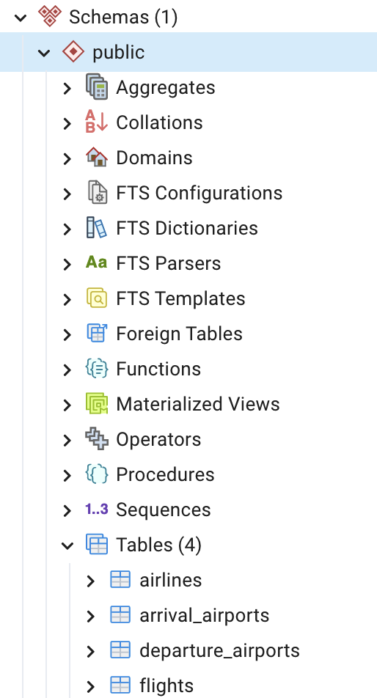
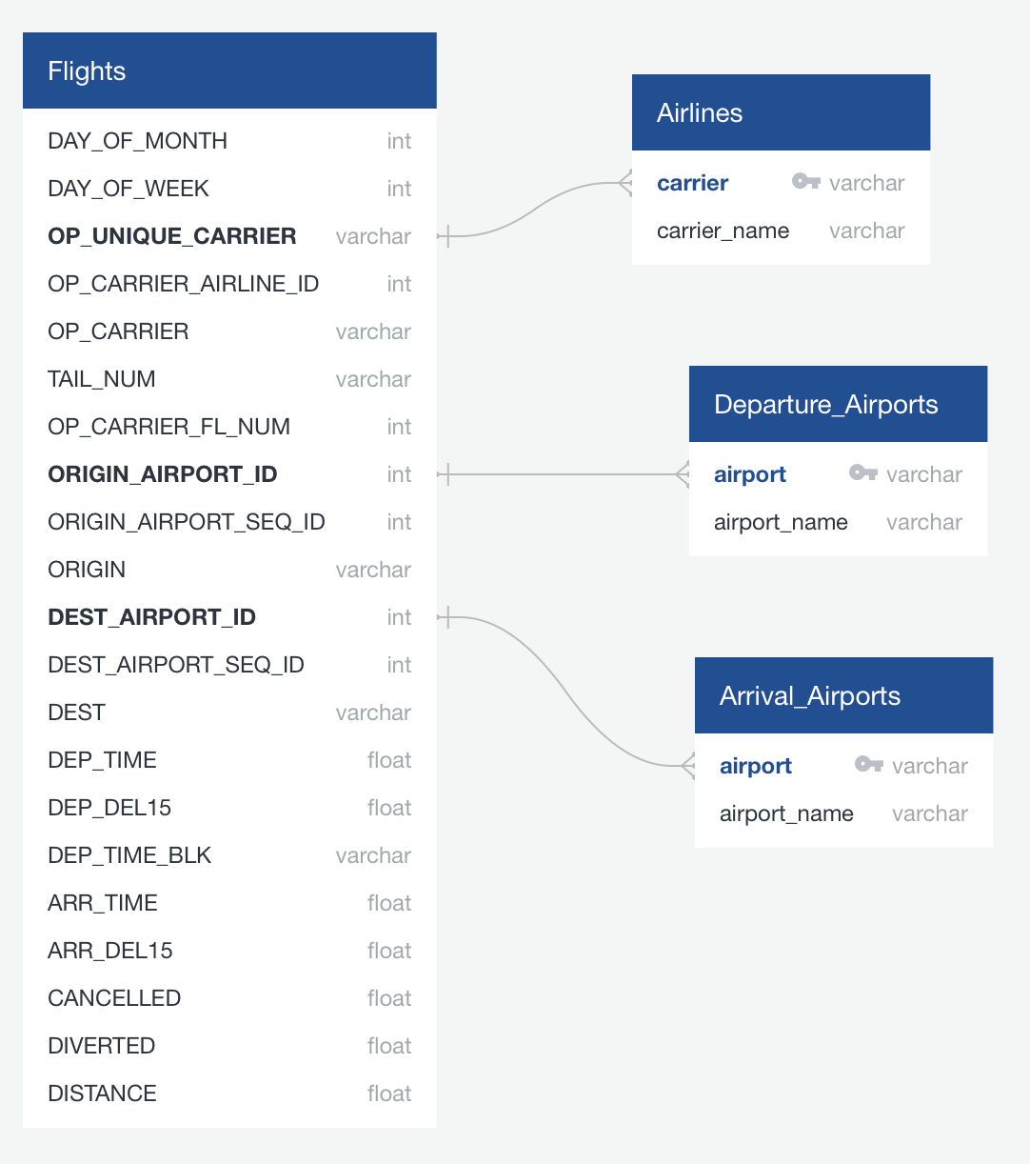
Database setup using AWS
PgAdmin
Quick DBD used to create ER Diagram

Slide 7
Machine Learning Models
Logistic Regression Model
Random Forest Classifier
Gradient Boosting Classifier

Slide 8
Logistic Regression Model
Training Accuracy: 93.21%
Testing Accuracy: 93.14%
Precision (weighted average): 93%
Recall (weighted average): 93%
F1-Score (weighted average): 93%
Picture of Results

Slide 9
Random Forest Classifier
Training Accuracy: 90.78%
Testing Accuracy: 89.69%
Precision (weighted average): 90%
Recall (weighted average): 90%
F1-Score (weighted average): 87%
Picture of Results

Slide 10
Gradient Boosting Classifier
Training Accuracy: 93.21%
Testing Accuracy: 93.21%
Precision (weighted average): 93%
Recall (weighted average): 93%
F1-Score (weighted average): 93%
Picture of Results

Slide 11
The best Model for our project: Gradient Boosting Classifier
It has the highest testing accuracy (93.21%) among the three models, which shows it works well with unseen data. It has a strong balance between precision, recall, and F1-score, indicating that it performs well across different metrics.
The model is not only good at identifying true positives but also at minimizing false positives and false negatives, making it the most reliable choice. We believe this will be the best model for our final project.

Slide 12
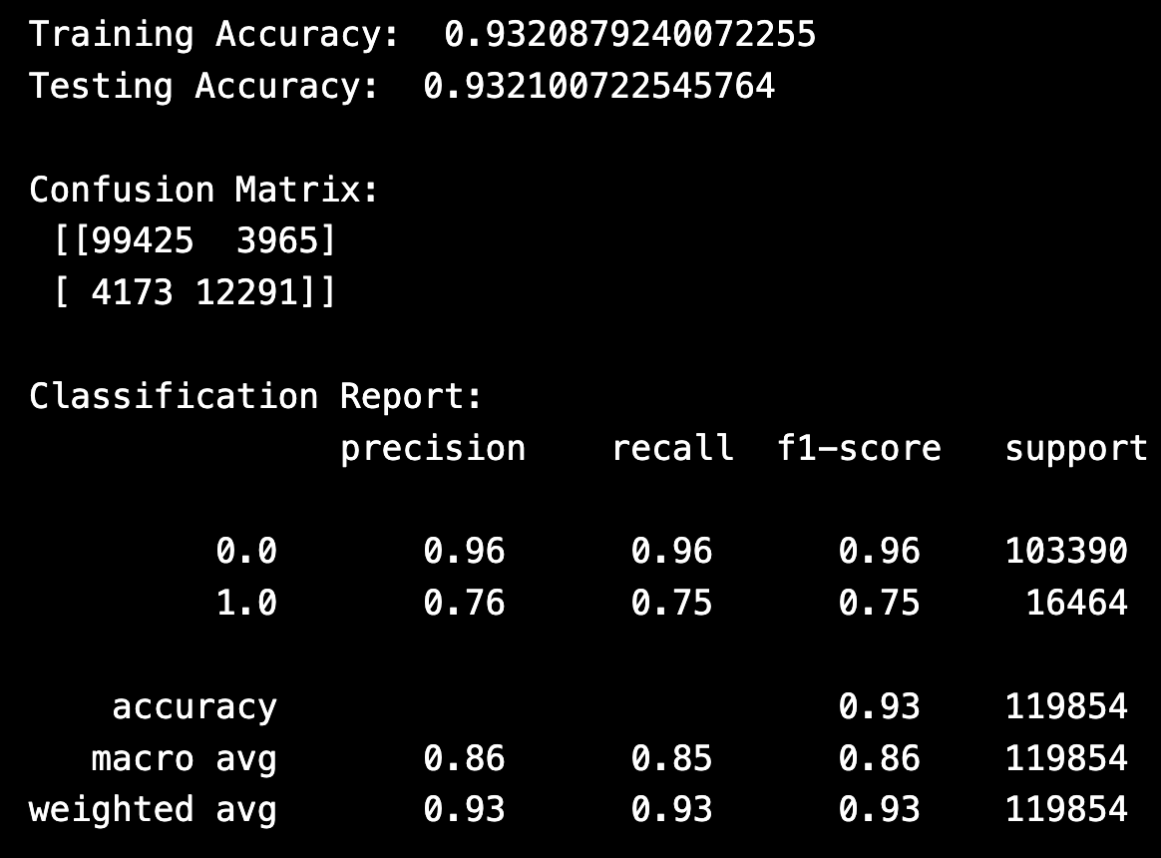
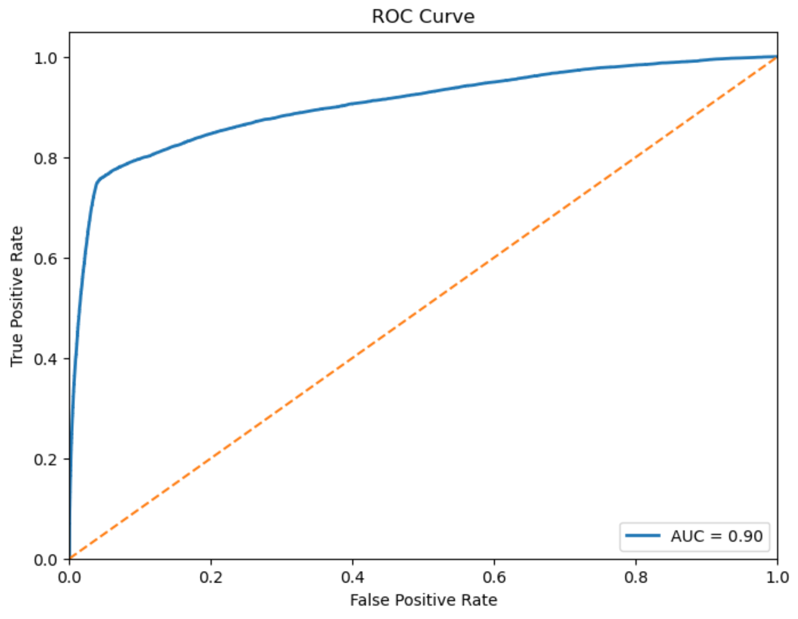
Gradient Boosting Classifier

Slide 13
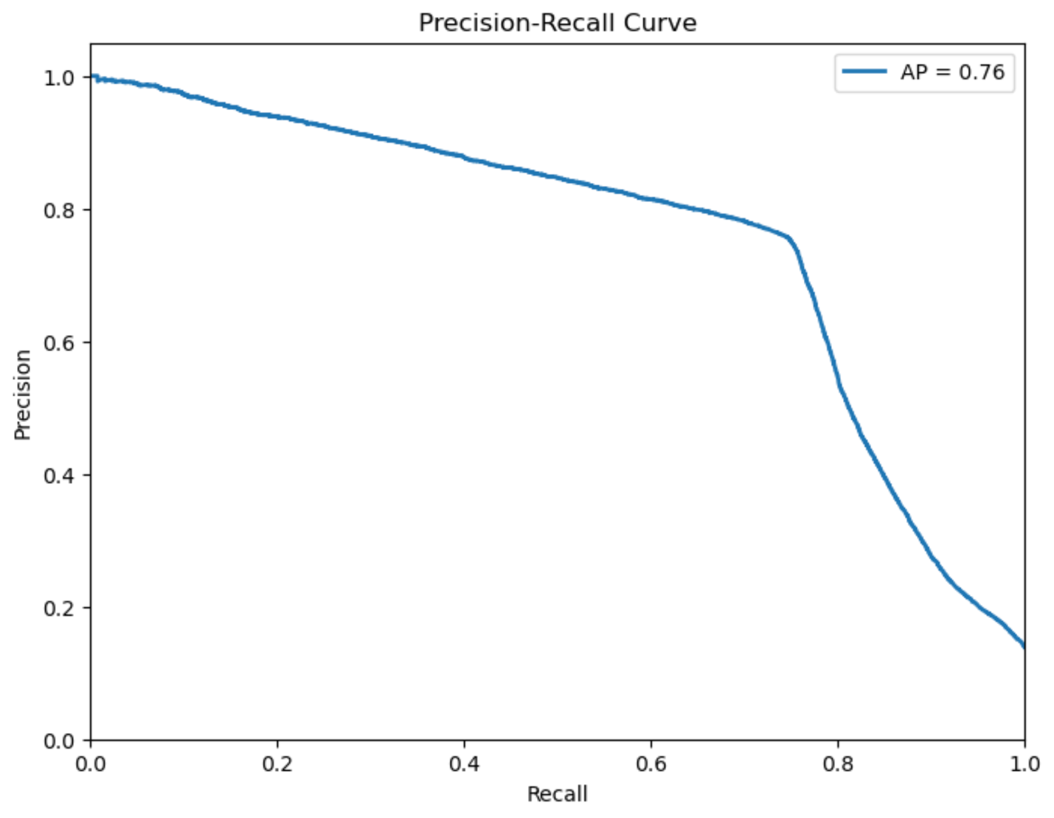
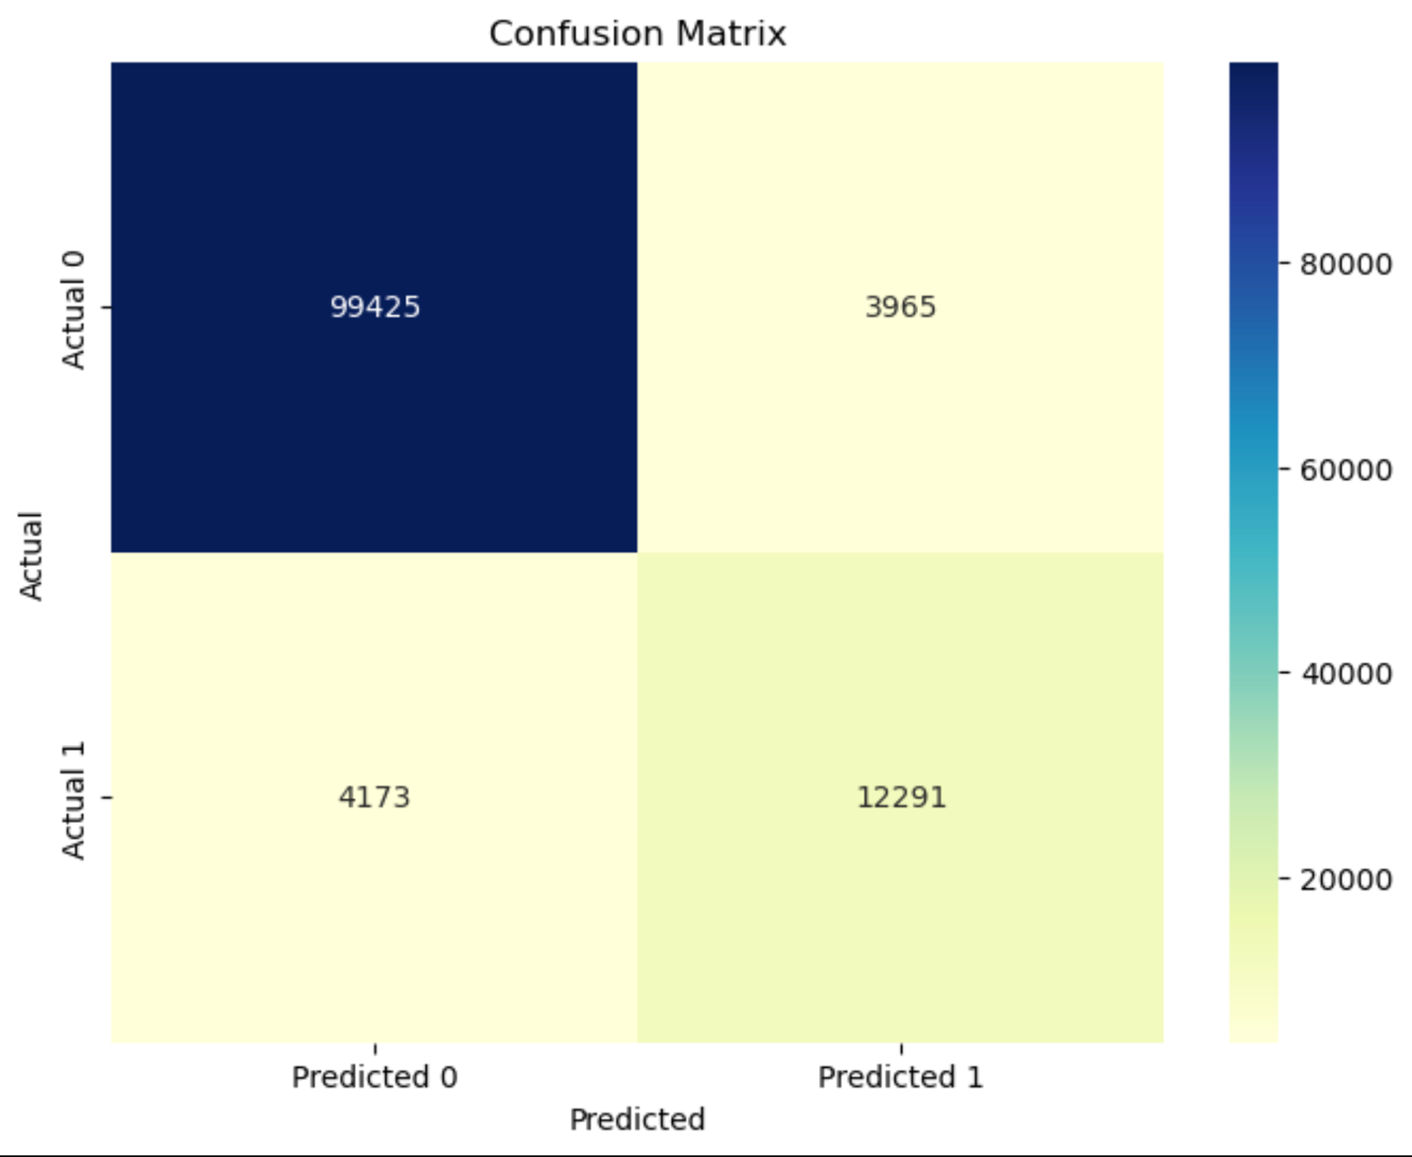
Gradient Boosting Classifier

Slide 14
Tableau Visualization Dashboard
https://public.tableau.com/app/profile/kennan.foust/viz/ProjectTableau_16832615644700/Dashboard1?publish=yes

Slide 15
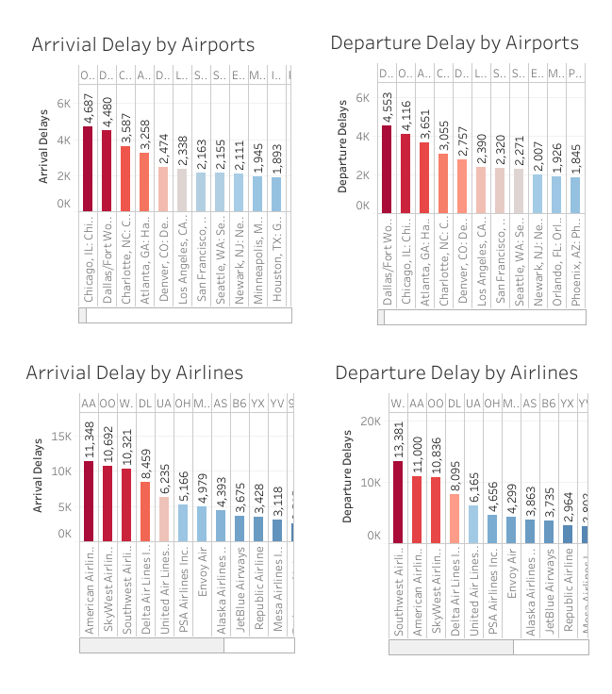
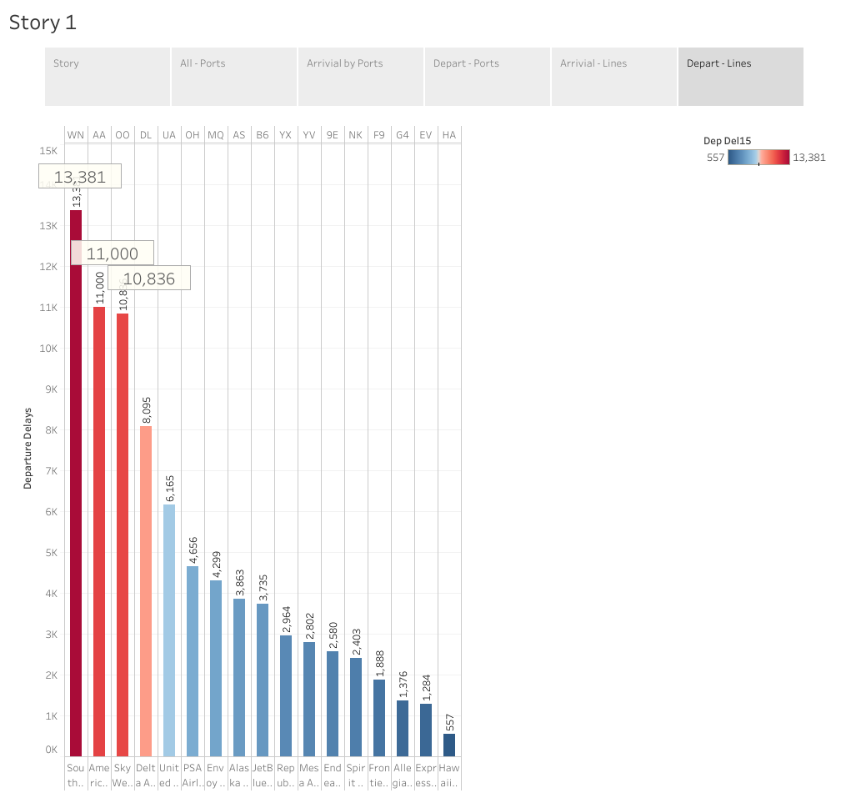
Tableau Visualizations

Slide 16
Recommendations for a Future Analysis
Get datasets on the actual causes for delays (weather, maintenance, etc…)

Slide 17
Anything the Team would have done differently

Slide 18
The End

